Slide 1
Greedy Algorithms
Huffman Coding
Knapsack Problem

Slide 2
Data Encoding for Data Compression
Normal Messaging
Fixed Length Encoding
Variable Length Encoding

Slide 3
Normal Messaging
BCCABBDDAECCBBAEDDCC
Length 20
Use ASCII Codes-8 bits per character
Total-160 bits required to encode

Slide 4
Fixed Length Encoding
BCCABBDDAECCBBAEDDCC
3-bit fixed length code representation
Bits required: 60 bits
Reference Table : 8*5 + 3*5=55
Total Bits required:115 bits
Frequency Fixed-length codeword codeword
‘a’ 3 000
‘b’ 5 001
‘c’ 6 010
‘d’ 4 011
‘e’ 2 100
20

Slide 5
Variable Length Coding
BCCABBDDAECCBBAEDDCC
Bits required: 45 bits, Reference Table : 8*5 + 12=52, Total Bits required:97 bits
Frequency Variable-length
codeword
‘a’ 3 011
‘b’ 5 10
‘c’ 6 11
‘d’ 4 00
‘e’ 2 010
Frequency Variable-length
codeword
‘a’ 3 101
‘b’ 5 01
‘c’ 6 11
‘d’ 4 00
‘e’ 2 100
OR
20
20
1
0
1
0
9
11
9
11
1
0
1
0
1
0
1
0
4
5
5
6
4
5
5
6
0
1
0
1
2
3
2
3

Slide 6
Huffman Codes
Huffman Codes
For compressing data (sequence of characters)
Widely used
Very efficient (saving 20-90%)
Use a table to keep frequencies of occurrence of characters.
Output binary string.
“Today’s weather is nice”
“001 0110 0 0 100 1000 1110”

Slide 7
Huffman Codes
Example:
Frequency Fixed-length Variable-length
codeword codeword
‘a’ 45000 000 0
‘b’ 13000 001 101
‘c’ 12000 010 100
‘d’ 16000 011 111
‘e’ 9000 100 1101
‘f’ 5000 101 1100
A file of 100,000 characters. Containing only ‘a’ to ‘f’
1*45000 + 3*13000 + 3*12000 + 3*16000 + 4*9000 + 4*5000 = 224,000 bits
1*45000 + 3*13000 + 3*12000 + 3*16000 + 4*9000 + 4*5000 = 224,000 bits
300,000 bits
eg. “abc” = “0101100”
eg. “abc” = “000001010”

Slide 8
Huffman Codes
A file of 100,000 characters.
Frequency Variable-length
(in thousands) codeword
‘a’ 45 0
‘b’ 13 101
‘c’ 12 100
‘d’ 16 111
‘e’ 9 1101
‘f’ 5 1100
100
0
1
a:45
55
1
0
25
30
0
1
0
1
c:12
b:13
14
d:16
0
1
f:5
e:9
To find an optimal code for a file:
File size must be smallest.
=> Can be represented by a full binary tree.
=> Usually less frequent characters are at bottom
Let C be the alphabet (eg. C={‘a’,’b’,’c’,’d’,’e’,’f’})
For each character c, no. of bits to encode all c’s occurrences = freq_{c}*depth_{c}
File size B(T) = Σ_{c∈C}freq_{c}*depth_{c}
A full binary tree every nonleaf node has 2 children

Slide 9
Huffman Codes
How do we find the optimal prefix code?
Huffman code (1952) was invented to solve it.
A Greedy Approach.
Q: A min-priority queue
f:5
e:9
c:12
b:13
d:16
a:45
c:12
b:13
14
d:16
a:45
14
d:16
25
a:45
f:5
e:9
f:5
e:9
c:12
b:13
25
30
a:45
a:45
55
100
c:12
b:13
d:16
25
30
a:45
55
14
c:12
b:13
25
30
f:5
e:9
14
d:16
c:12
b:13
14
d:16
f:5
e:9
f:5
e:9

Slide 10

Huffman Codes
Q: A min-priority queue
f:5
e:9
c:12
b:13
d:16
a:45
c:12
b:13
14
d:16
a:45
14
d:16
25
a:45
f:5
e:9
f:5
e:9
c:12
b:13
….
HUFFMAN(C)
1 Build Q from C
2 For i = 1 to |C|-1
3 Allocate a new node z
4 z.left = x = EXTRACT_MIN(Q)
5 z.right = y = EXTRACT_MIN(Q)
6 z.freq = x.freq + y.freq
7 Insert z into Q in correct position.
8 Return EXTRACT_MIN(Q)
If Q is implemented as a binary min-heap,
“Build Q from C” is O(nlogn)
“EXTRACT_MIN(Q)” is O(lg n)
“Insert z into Q” is O(lg n)
Huffman(C) is O(n lg n)

Slide 11
Problem-2
Construct a Huffman tree and the Huffman code for the following characters
Value | A | B | C | D | E | F
Frequency | 5 | 25 | 7 | 15 | 4 | 12

Slide 12
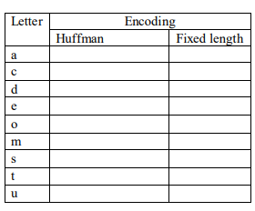
Problem-3
Assume that the numbers given below represent counts of letters in the hundreds from a file. For example, in the file there will be exactly 20 * 100 occurrences of the letter ‘a’ , 11*100 occurrence of the letter ‘c’, etc. a: 20, c:11, d:2, e: 10, o:15, m:8, s:10, t:22, u: 2
a) What is an optimal Huffman code based on the following set of frequencies?
1) Draw the tree. Show your work at every step.
2) Fill in the table on the right the Huffman encoding for each letter.
3) We encode the file using the Huffman codes produced above. How much memory will the file require with this encoding?
b) Fixed-length encoding:
1) Fill in the table the fixed-length encoding for each letter.
2) What will be the file size when the fixed-length encoding is used?

Slide 13

Review: The Knapsack Problem
The famous knapsack problem:
“A thief breaks into a museum. Fabulous paintings, sculptures, and jewels are everywhere. The thief has a good eye for the value of these objects, and knows that each will fetch hundreds or thousands of dollars on the clandestine art collector’s market. But, the thief has only brought a single knapsack to the scene of the robbery, and can take away only what he can carry. What items should the thief take to maximize the haul?”

Slide 14
Review: The Knapsack Problem
More formally, the 0-1 knapsack problem:
The thief must choose among n items, where the ith item worth p_{i} dollars and weighs w_{i} pounds
Carrying at most W pounds, maximize value
Note: assume v_{i}, w_{i}, and W are all integers
“0-1” b/c each item must be taken or left in entirety
A variation, the fractional knapsack problem:
Thief can take fractions of items
Think of items in 0-1 problem as gold ingots, in fractional problem as buckets of gold dust

Slide 15
Fractional Knapsack Problem
In fractional knapsack problem, where we are given a set S of n Objects, s.t., each item O has a positive profit p_{i} and a positive weight w_{i}, and we wish to find the maximum-benefit subset that doesn’t exceed a given weight W.
We are also allowed to take arbitrary fractions of each item.

Slide 16
Fractional Knapsack Problem
Object
1 | 2 | 3 | 4 | 5 | 6 | 7
10 | 5 | 15 | 7 | 6 | 18 | 3
2 | 3 | 5 | 7 | 1 | 4 | 1
Profit p_{i}
Weight w_{i}

Slide 17
Fractional Knapsack Problem-solved
Max wt Knapsack can hold– W=15
Object
1 | 2 | 3 | 4 | 5 | 6 | 7
10 | 5 | 15 | 7 | 6 | 18 | 3
2 | 3 | 5 | 7 | 1 | 4 | 1
5 | 1.6 | 3 | 1 | 6 | 4.5 | 3
1 | 2/3 | 1 | 0 | 1 | 1 | 1
2 | 2 | 5 | 0 | 1 | 4 | 1
Profit p_{i}
Weight w_{i}
p_{i} / w_{i}
Sol^{n} Vector X

Slide 18
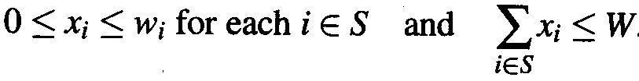

Fractional Knapsack Problem
I.e., we can take an amount x_{i} of each item i such that
The total benefit of the items taken is determined by the objective function
p_{i}

Slide 19
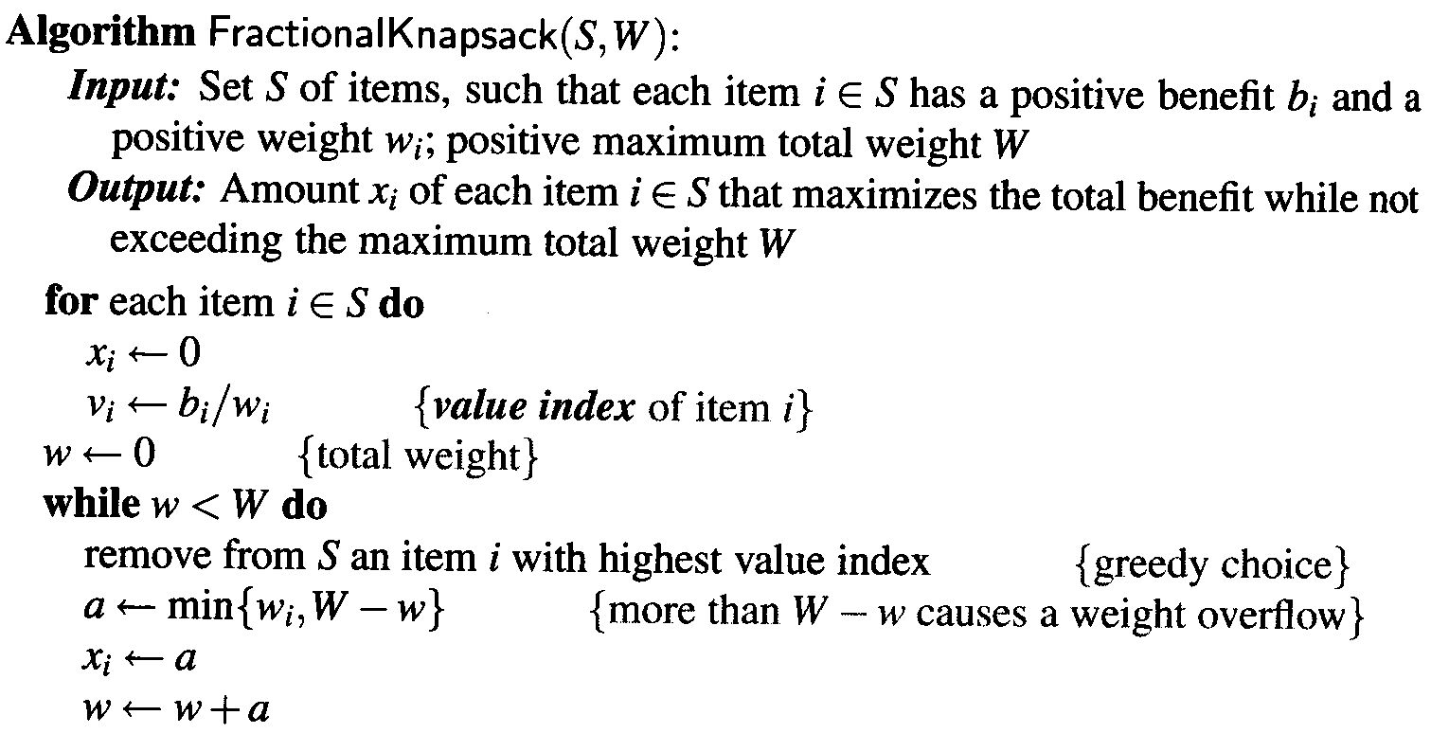


Fractional Knapsack Problem

Slide 20
Fractional Knapsack Problem
In the solution we use a heap-based PQ to store the items of S, where the key of each item is its value index
With PQ, each greedy choice, which removes an item with the greatest value index, takes O(log n) time
The fractional knapsack algorithm can be implemented in time O(n log n).

Slide 21
Problem-2
Consider that the capacity of the knapsack W = 60 and the list of provided items are shown in the following table.
Item | A | B | C | D
Profit | 280 | 100 | 120 | 120
Weight | 40 | 10 | 20 | 24

Slide 22
Review: The Knapsack Problem And Optimal Substructure
Both variations exhibit optimal substructure
To show this for the 0-1 problem, consider the most valuable load weighing at most W pounds
If we remove item j from the load, what do we know about the remaining load?
A: remainder must be the most valuable load weighing at most W - w_{j} that thief could take from museum, excluding item j

Slide 23
Solving The Knapsack Problem
The optimal solution to the fractional knapsack problem can be found with a greedy algorithm
How?
The optimal solution to the 0-1 problem cannot be found with the same greedy strategy
Greedy strategy: take in order of dollars/pound
Example: 3 items weighing 10, 20, and 30 pounds, knapsack can hold 50 pounds
Suppose item 2 is worth $100. Assign values to the other items so that the greedy strategy will fail

Slide 24
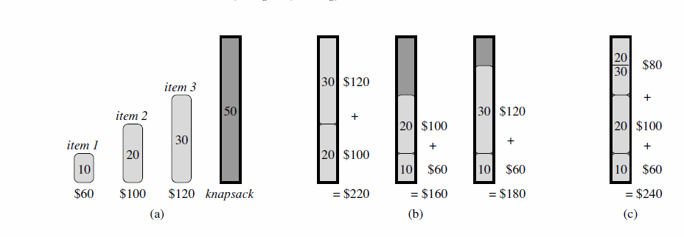

Slide 25
The Knapsack Problem: Greedy Vs. Dynamic
The fractional problem can be solved greedily
The 0-1 problem cannot be solved with a greedy approach
however, it can be solved with dynamic programming

